Slide 1
Privilege Escalation Techniques on vulnerable Linux Servers
Project Group 2
Dharan Kumar Kunati
Sai Meghana Evuri
Ganesh Seeram
Venkata Sai Chandrika Gudipati

Slide 2
Introduction
Privilege escalation refers to the process of increasing the level of access and control over a computer system or network beyond what an authorized user should have.
Techniques and Methods used by attackers to gain access to vulnerable Linux server.
Mitigation steps that can be followed.

Slide 3
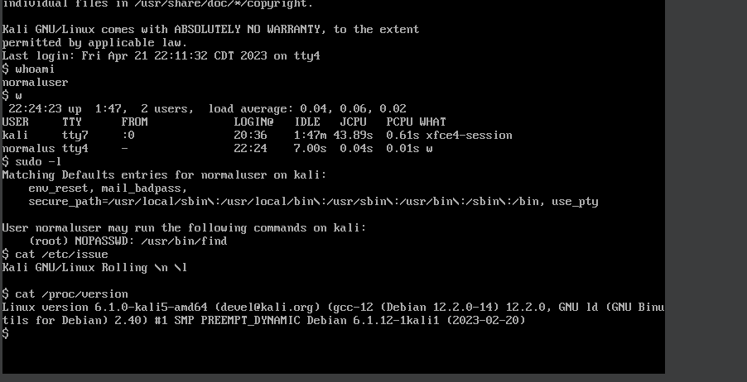
System Enumeration
OS Version and Kernel Version

Slide 4
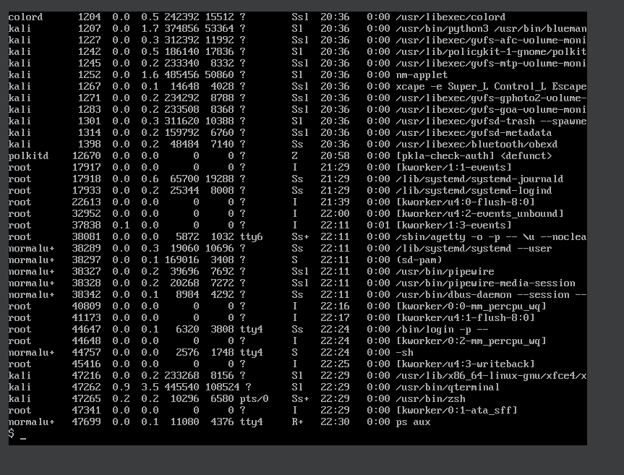
Applications
The Services running and user privileges
Command: ps aux

Slide 5
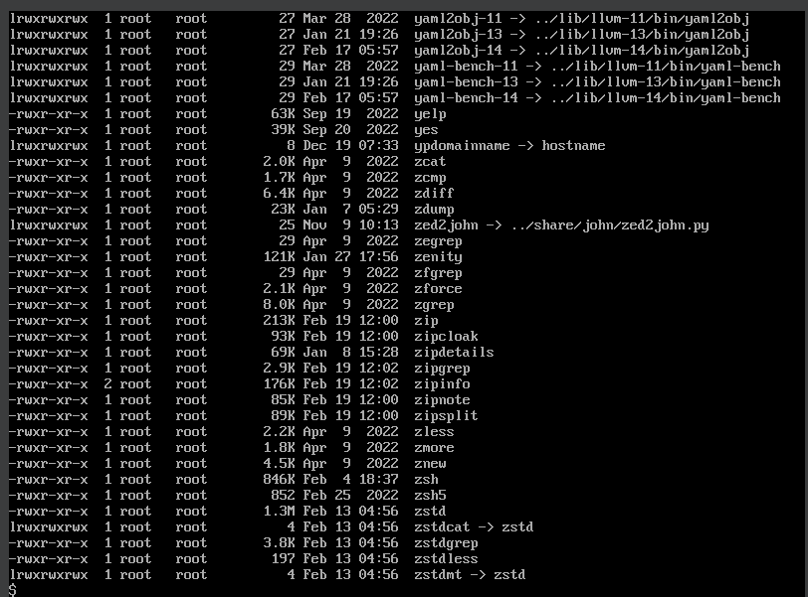
Permissions of the current running applications
Command:
ls -alh /usr/bin/

Slide 6
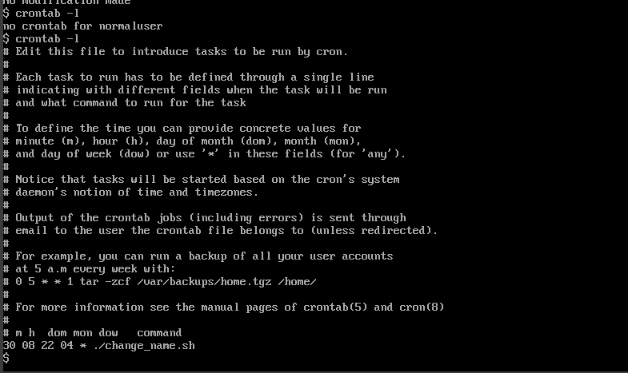
How do we know the jobs scheduled?
Crontab shows us the scheduled entries with time.

Slide 7
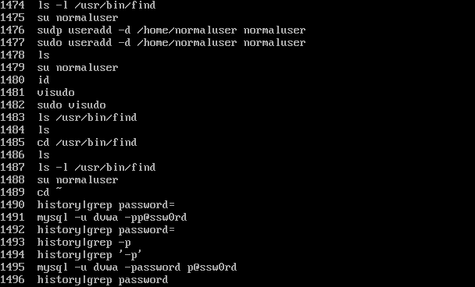
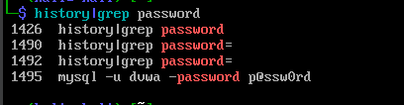
History

Slide 8
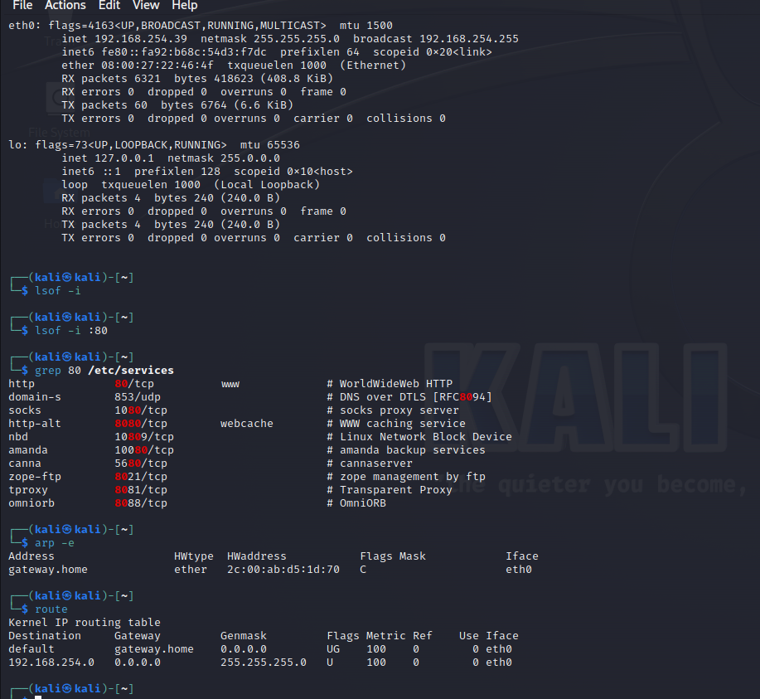
Network enumeration

Slide 9
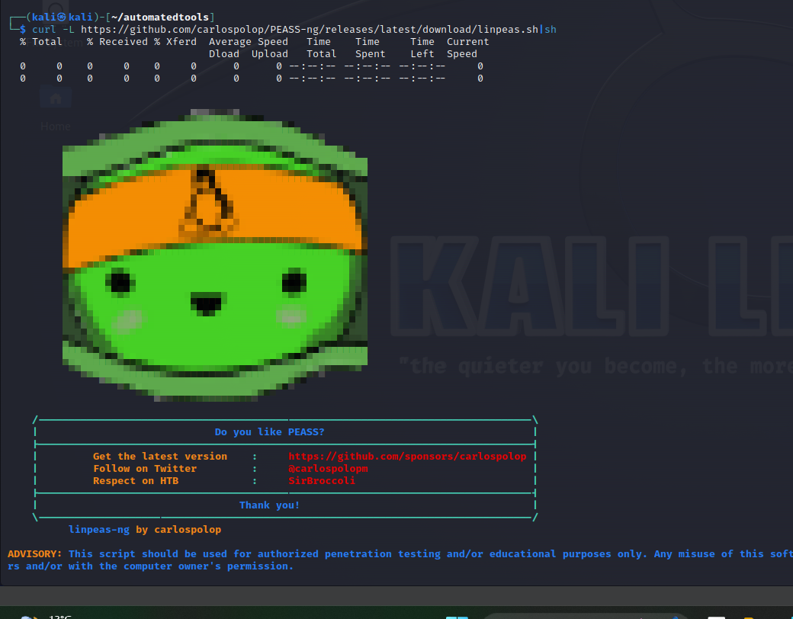
Automatic Enumeration
We are using some tools to increase the search capability, finding Vulnerabilities.
Linux privilege escalation awesome script. It is a script that searches for possible path to escalate privileges on linux/unix host.

Slide 10
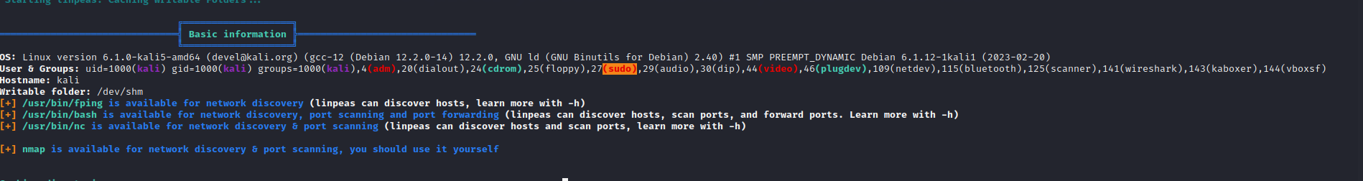
Basic information

Slide 11
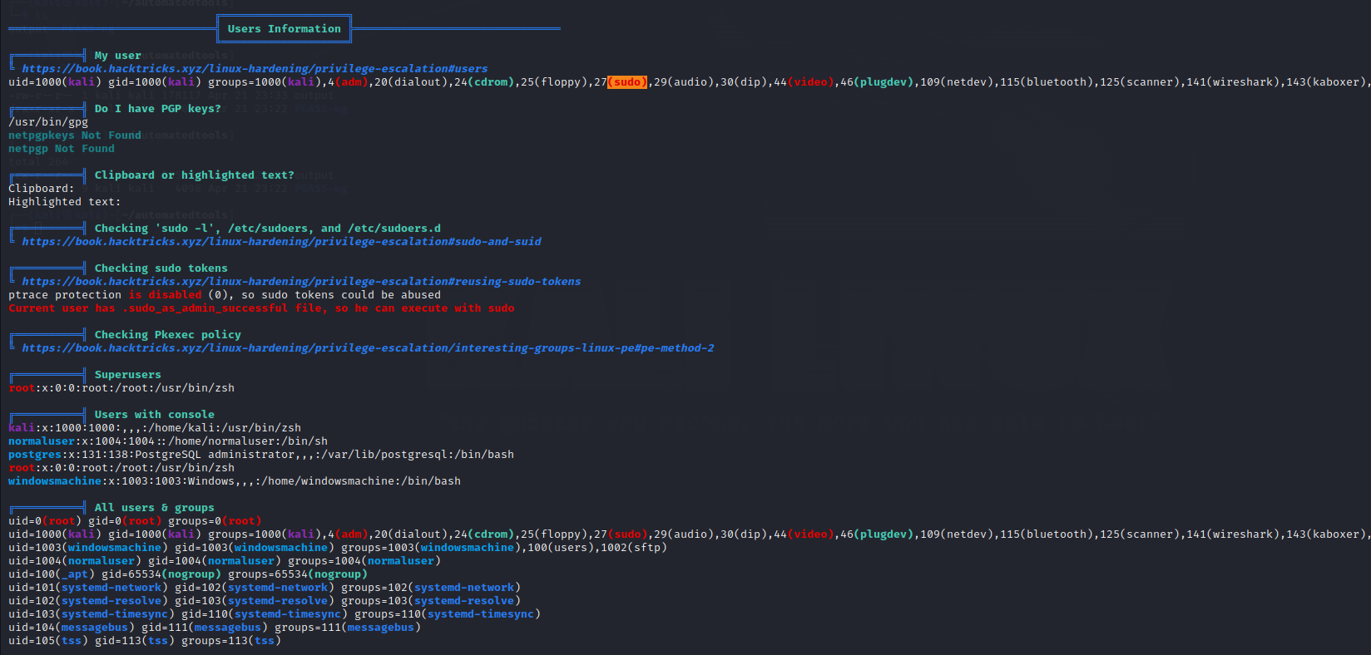
User Information

Slide 12
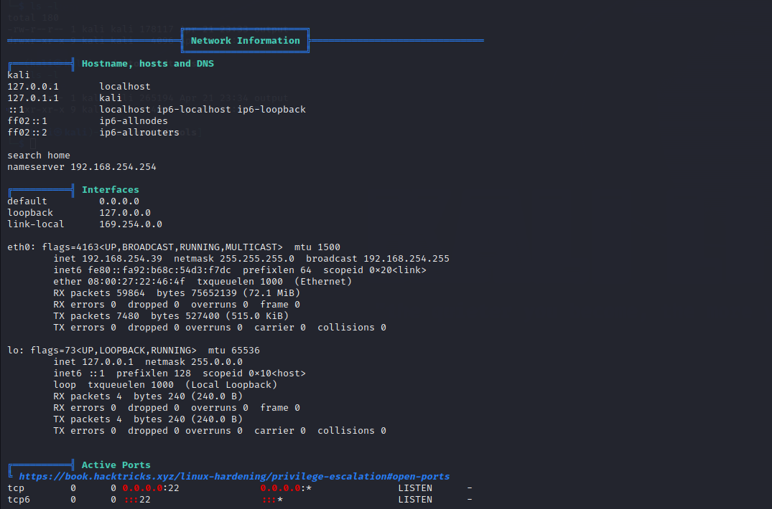
Network Information

Slide 13
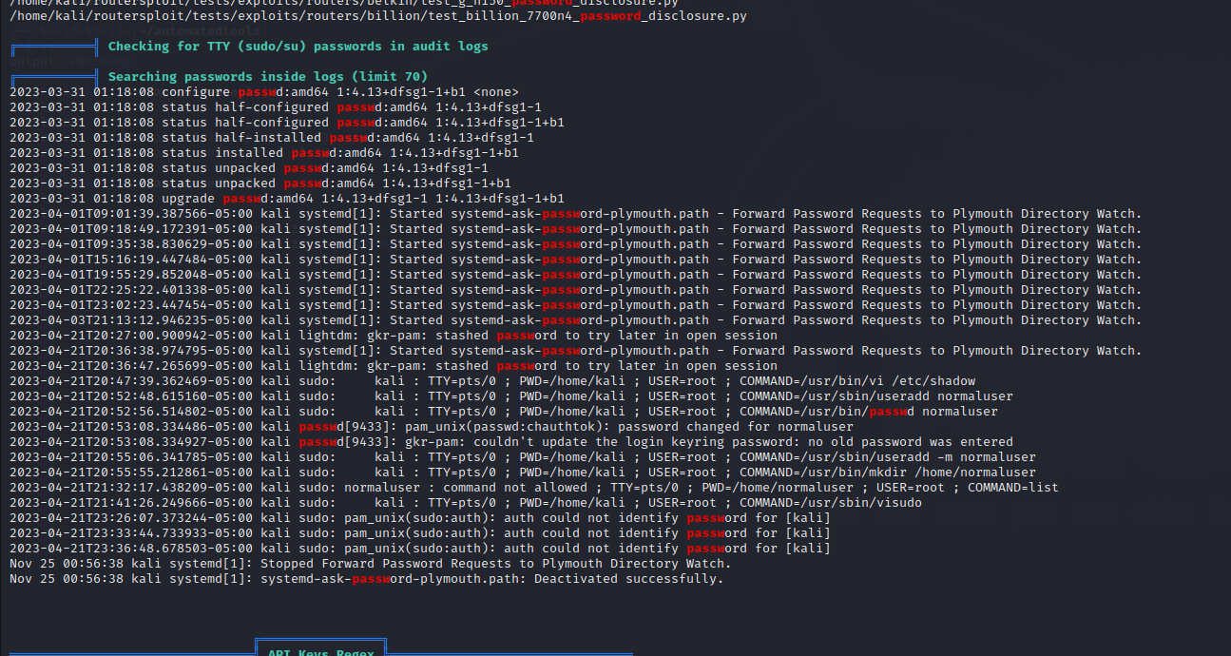
Passwords

Slide 14
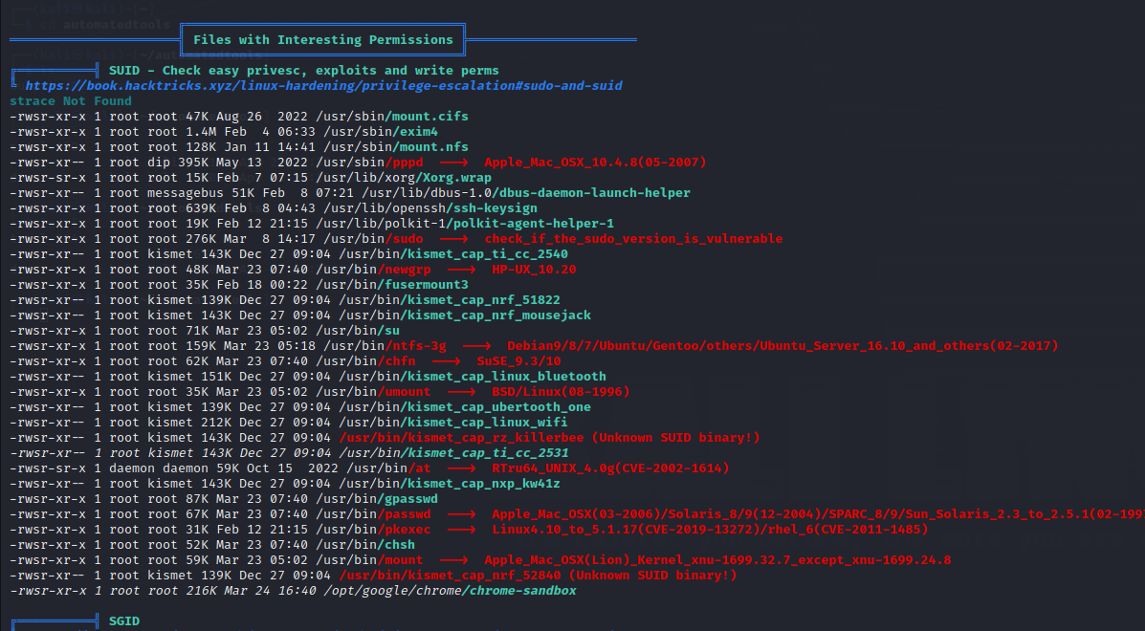
Permissions of Interesting files

Slide 15
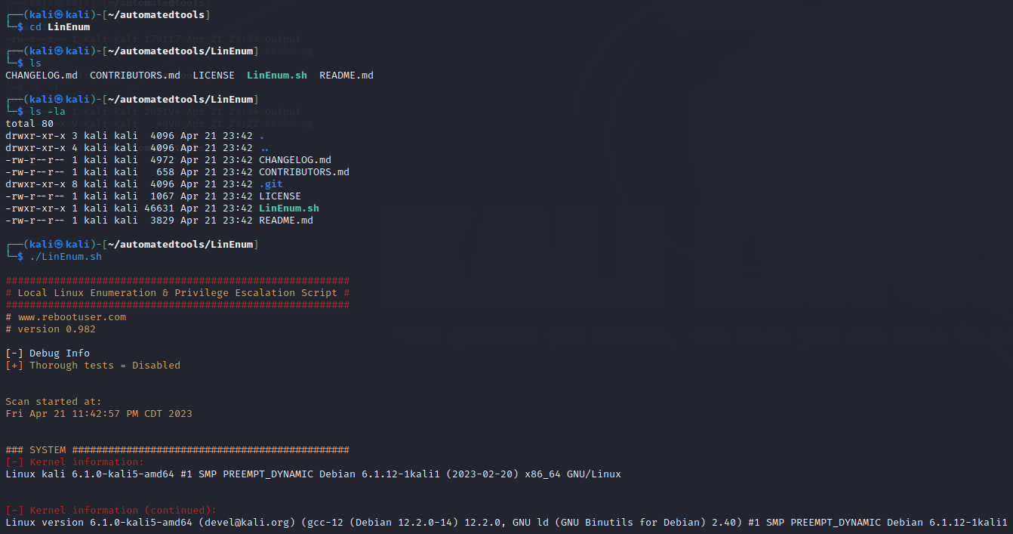
Automated enum tool - Linenum

Slide 16
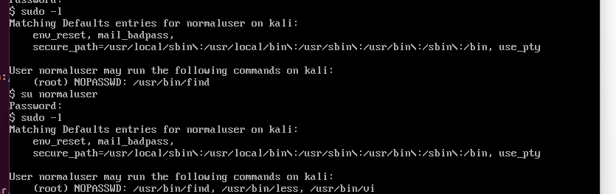
Privilege escalation using Sudo Shell escaping

Slide 17
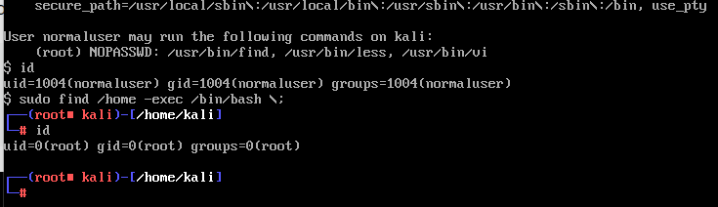
using find file

Slide 18
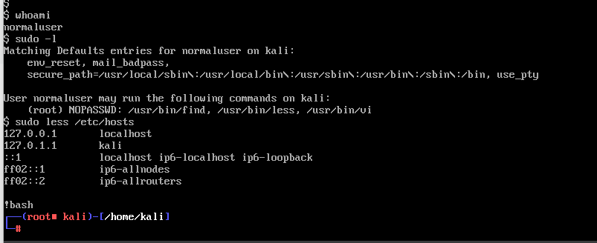
using less file

Slide 19
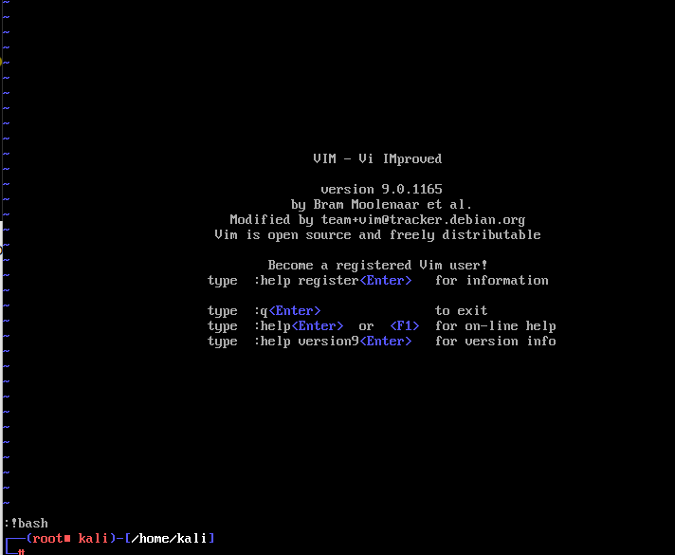
using vi file

Slide 20
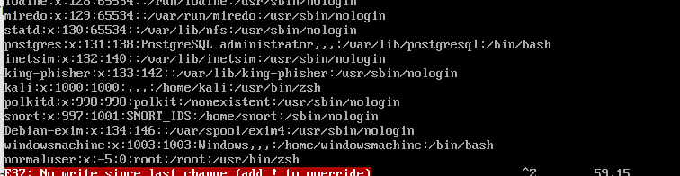
Changing the contents of password file

Slide 21
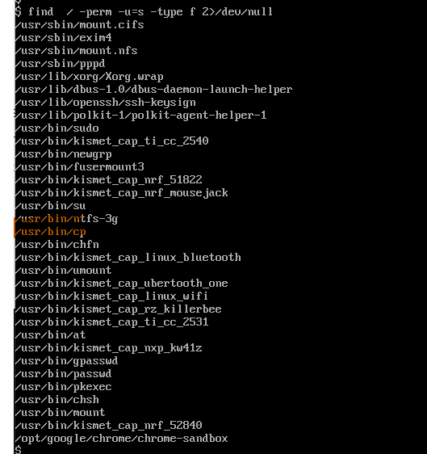
SUID Binary

Slide 22
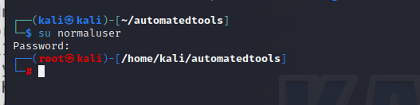
Exploiting suid binaries

Slide 23
How to Defend?
Restrictive File permissions
Implement strong authentication and authorization controls
Regular security assessments
Use Role-Based Access Control

Slide 24
Questions?

